Slide 1




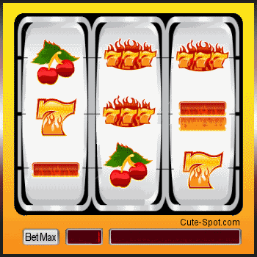

PLAY
30 IRREGULAR VERBS from A to H

Slide 2
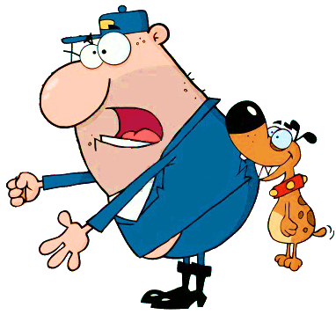



Click on one of the three SPIN buttons and say the other two forms of the irregular verb corresponding to the picture.

Slide 3





NEXT
begin
come
go
drink
read
began
came
went
drank
read
begun
come
gone
drunk
read
1/30

Slide 4

NEXT
bite
do
eat
drink
read
bit
did
ate
drank
read
bitten
done
eaten
drunk
read
2/30

Slide 5
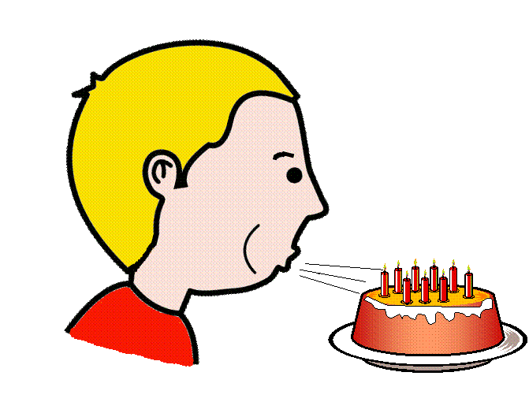
NEXT
blow
forget
go
drink
read
blew
forgot
went
drank
read
blown
forgoten
gone
drunk
read
3/30

Slide 6
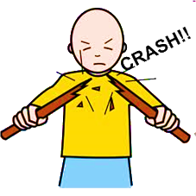
NEXT
break
give
go
drink
read
broke
gave
went
drank
read
broken
given
gone
drunk
read
4/30

Slide 7
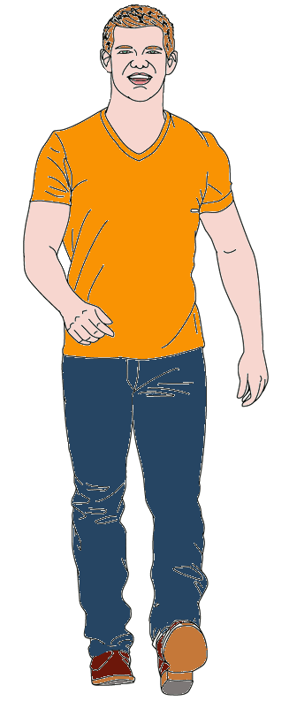
NEXT
bring
give
go
drink
read
brought
gave
went
drank
read
brought
given
gone
drunk
read
5/30

Slide 8

NEXT
build
give
go
drink
read
built
gave
went
drank
read
built
given
gone
drunk
read
6/30

Slide 9
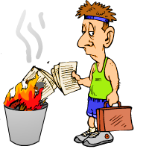
NEXT
burnt
burned
gave
went
drank
read
burnt
burned
given
gone
drunk
read
burn
give
go
drink
read
7/30

Slide 10
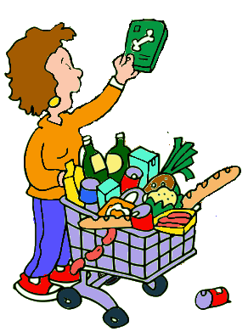
NEXT
buy
give
go
drink
read
bought
gave
went
drank
read
bought
given
gone
drunk
read
8/30

Slide 11
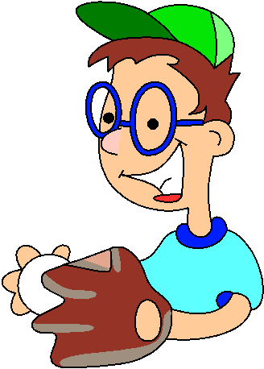
NEXT
catch
give
go
drink
read
caught
gave
went
drank
read
caught
given
gone
drunk
read
9/30

Slide 12
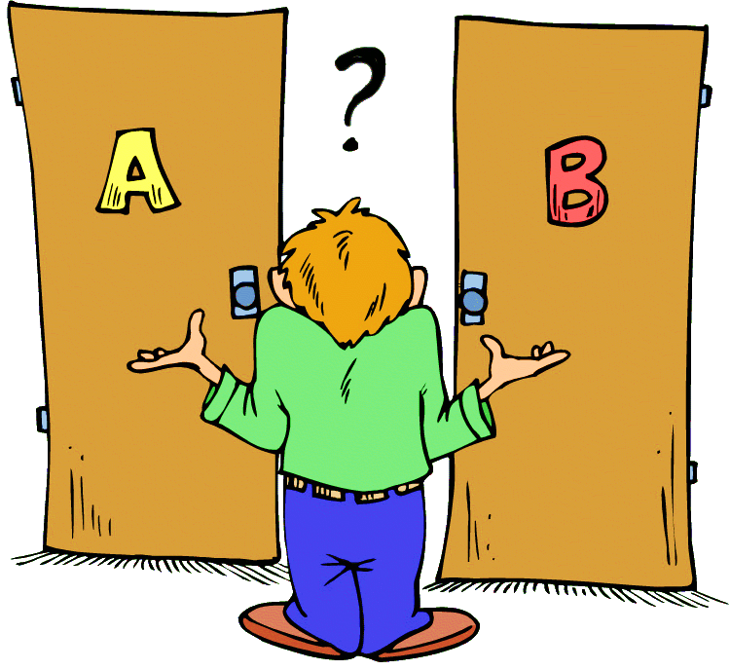
NEXT
choose
give
go
drink
read
chose
gave
went
drank
read
chosen
given
gone
drunk
read
10/30

Slide 13
NEXT
come
give
go
drink
read
came
gave
went
drank
read
come
given
gone
drunk
read
11/30

Slide 14


NEXT
cut
give
go
drink
read
cut
gave
went
drank
read
cut
given
gone
drunk
read
12/30

Slide 15


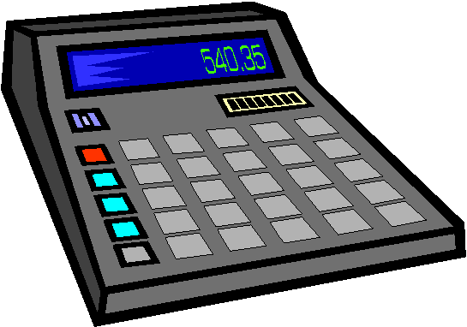
NEXT
do
give
go
drink
read
did
gave
went
drank
read
done
given
gone
drunk
read
13/30

Slide 16
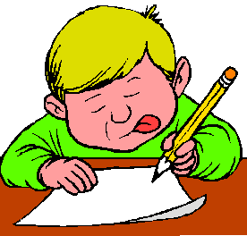

NEXT
draw
give
go
drink
read
drew
gave
went
drank
read
drawn
given
gone
drunk
read
14/30

Slide 17

NEXT
dreamt/
dreamed
gave
went
drank
read
dreamt/
dreamed
given
gone
drunk
read
dream
give
go
drink
read
15/30

Slide 18
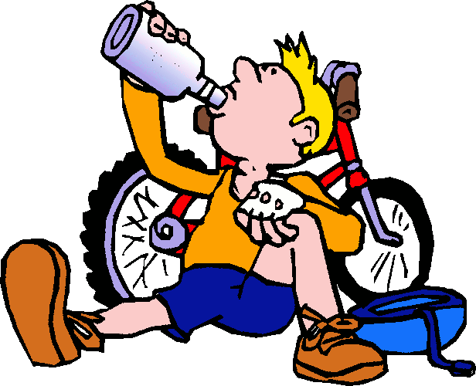
NEXT
drink
give
go
sing
read
drank
gave
went
sang
read
drunk
given
gone
sung
read
16/30

Slide 19
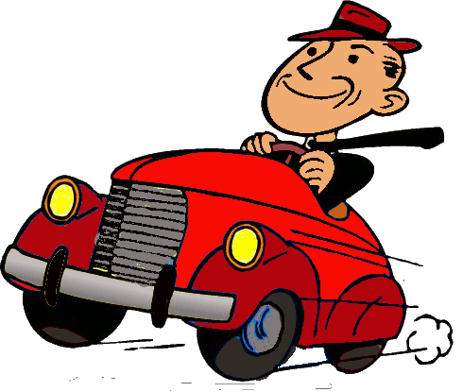
NEXT
drive
give
go
sing
read
drove
gave
went
sang
read
driven
given
gone
sung
read
17/30

Slide 20
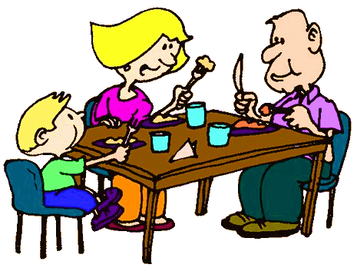
NEXT
eat
give
go
sing
read
ate
gave
went
sang
read
eaten
given
gone
sung
read
18/30

Slide 21
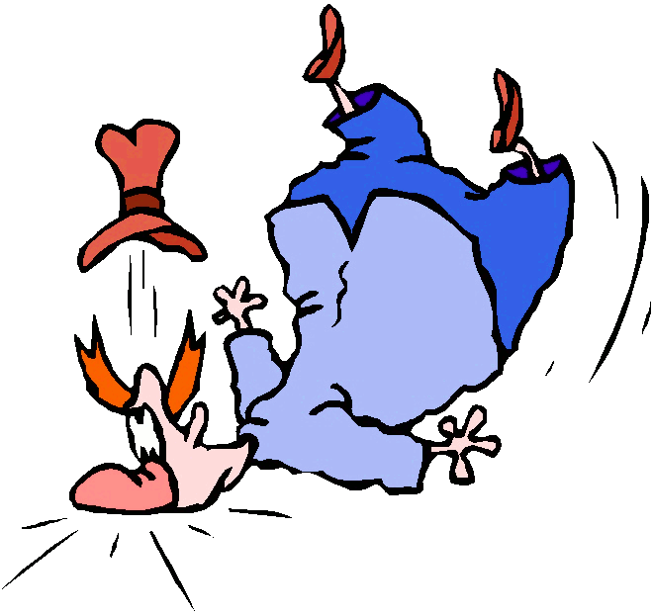
NEXT
fall
give
go
sing
read
fell
gave
went
sang
read
fallen
given
gone
sung
read
19/30

Slide 22
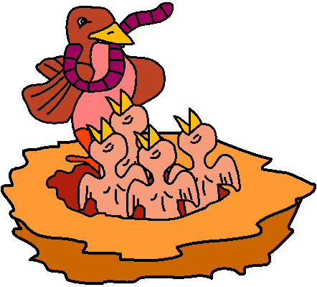
NEXT
feed
give
go
sing
read
fed
gave
went
sang
read
fed
given
gone
sung
read
20/30

Slide 23
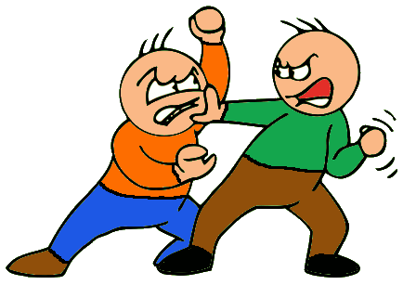
NEXT
fight
give
go
sing
read
fought
gave
went
sang
read
fought
given
gone
sung
read
21/30

Slide 24

NEXT
find
give
go
sing
read
found
gave
went
sang
read
found
given
gone
sung
read
22/30

Slide 25

NEXT
fly
give
go
sing
read
flew
gave
went
sang
read
flown
given
gone
sung
read
23/30

Slide 26
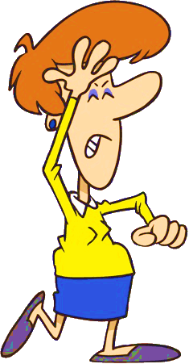
NEXT
forget
give
go
sing
read
forgot
gave
went
sang
read
forgotten
given
gone
sung
read
24/30

Slide 27
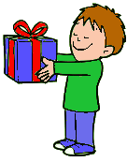
Thanks!
NEXT
get
give
go
sing
read
got
gave
went
sang
read
got
given
gone
sung
read
25/30

Slide 28
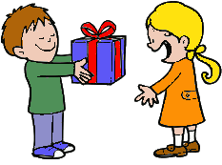
NEXT
give
drink
go
sing
read
gave
drank
went
sang
read
given
drunk
gone
sung
read
26/30

Slide 29
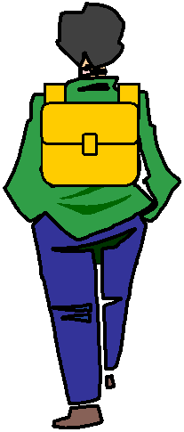
NEXT
go
drink
pay
sing
read
went
drank
paid
sang
read
gone
drunk
paid
sung
read
27/30

Slide 30

NEXT
grow
drink
pay
sing
read
grew
drank
paid
sang
read
grown
drunk
paid
sung
read
28/30

Slide 31
NEXT
have
drink
pay
sing
read
had
drank
paid
sang
read
had
drunk
paid
sung
read
29/30

Slide 32

EXIT
hear
drink
pay
sing
read
heard
drank
paid
sang
read
heard
drunk
paid
sung
read
30/30

