Slide 1
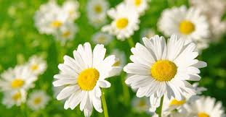
PLANTS

Slide 2
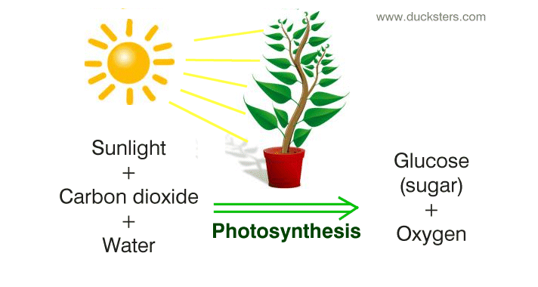
NUTRITION IN PLANTS
Most plants make their own food.
All plants need three things to make their own food.
Water
Sunlight
Carbon dioxide

Slide 3
What is Photosynthesis?
The word photosynthesis can be separated to make two smaller words:
“photo” which means light
“synthesis” which means putting together
Plants need food but they do not have to wait on people or animals to provide for them. Most plants are able to make their own food whenever they need it. This is done using light and the process is called photosynthesis.
Photosynthesis is the process by which plants make their own food.

Slide 4
What happens during Photosynthesis?
The photosynthesis process takes place in the leaves of plants.
Water and minerals from the soil are transported to the leaves.
The leaves absorb carbon dioxide that is a gas in the air.
All these ingredients: water, minerals and carbon dioxide is called raw sap.
The leaves are made up of very small cells. wich contains a green chemical called chlorophyll which gives leaves their green color.
The chlorophyll is the most important part on Photosynthesis as it tranforms the raw sap into elaborated sap with the energy of the sun.

Slide 5
What happens during Photosynthesis?
Chlorophyll absorbs the sun’s energy and transforms raw sap into elaborated sap
Oxygen is released from the leaves into the atmosphere in this process.
The elaborated sap is glucose or food for plants.
This food provides energy for the growth and development of plants and also it is stored in leaves, roots or fruits for later use by plants.

Slide 6
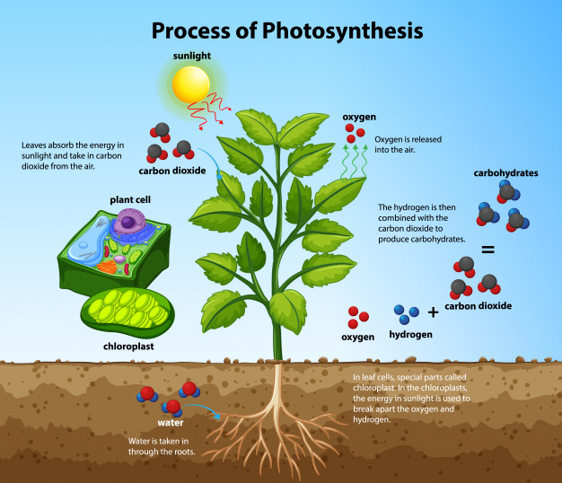

Slide 7
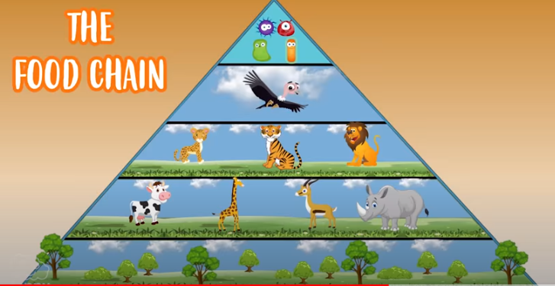
Why are plants so important.
Without plants there would be no live on the Earth.
We wouldn´t have oxygen to breath or food to eat.
Herbivores eat plants and carnivores eat hervibores son without plants there would be no food.
Also we wouldn´t be able to breath.
Plants transforms CO2 into O2 so they help us to clean the air.

